Slide 1
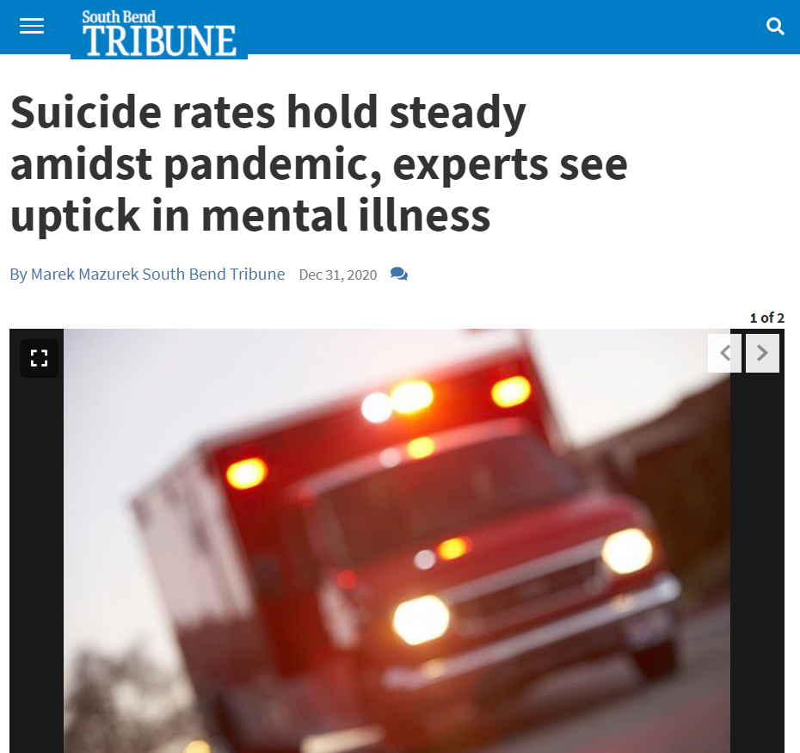
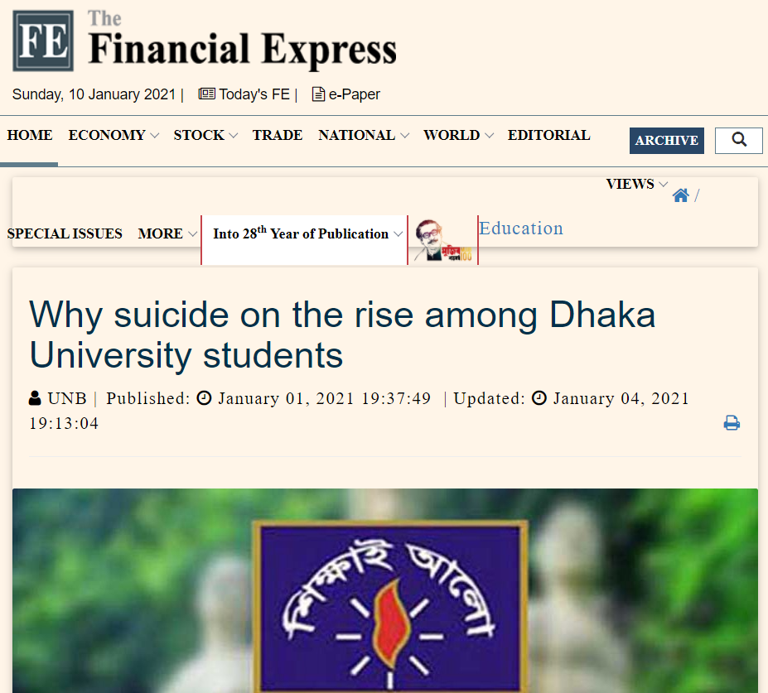
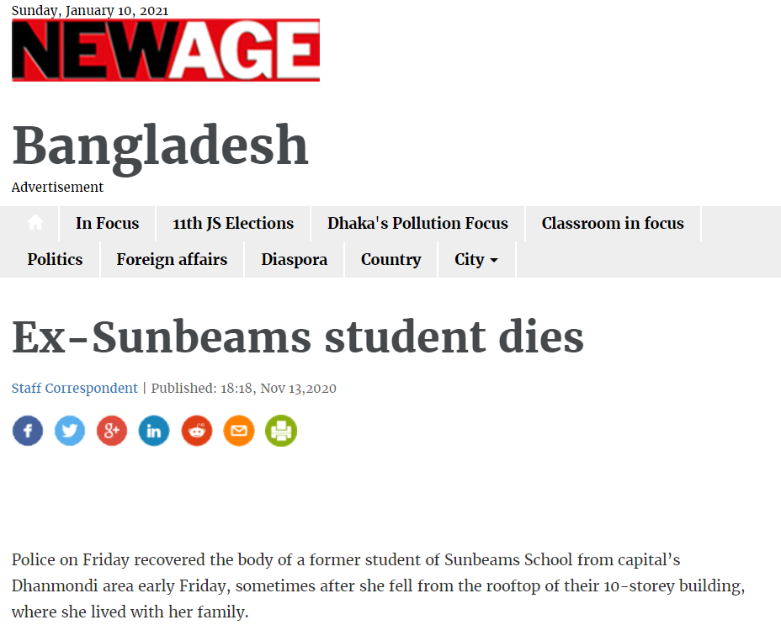
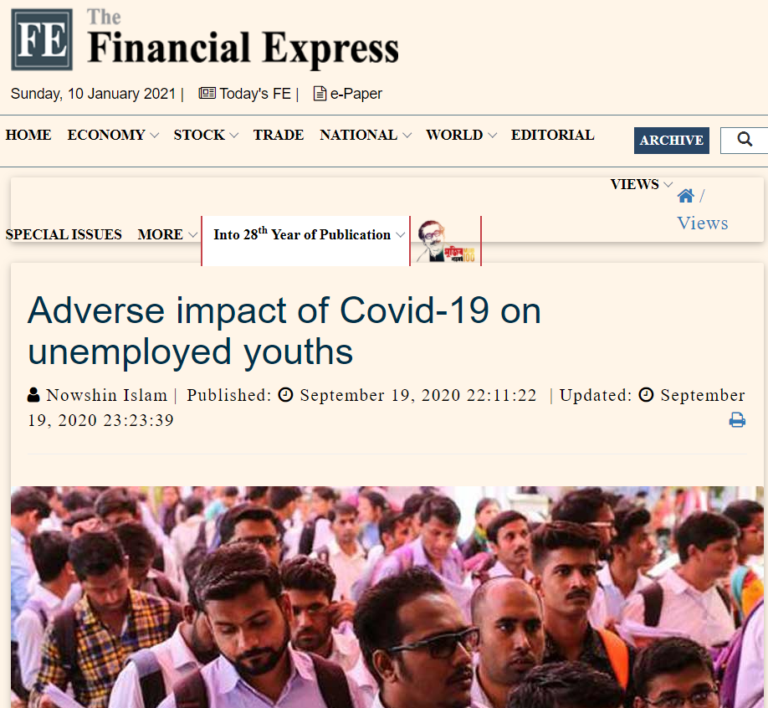
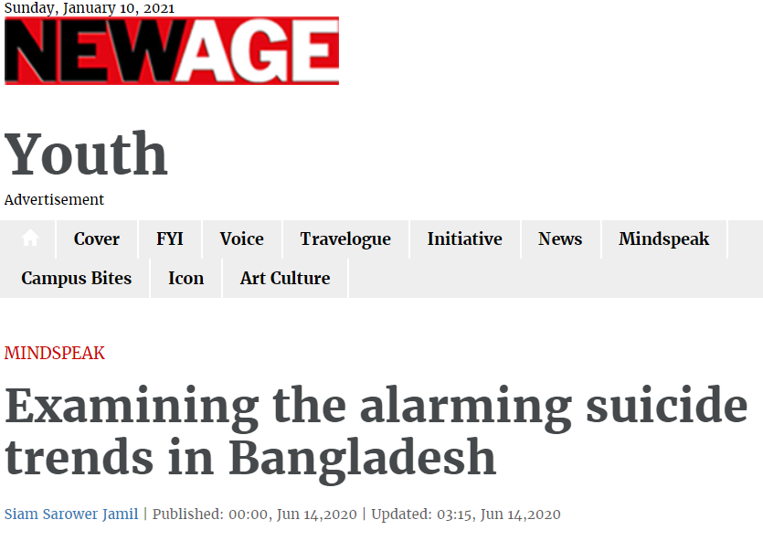
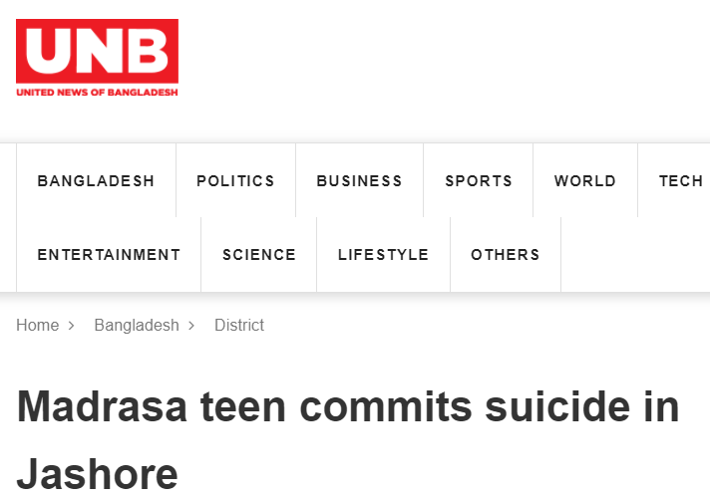
Perspective on Why are suicide cases on the rise in this pandemic?
Suicide often stems from a deep feeling of hopelessness. The inability to see solutions to problems or to cope with challenging life circumstances may lead people to see taking their own lives as the only solution to what is really a temporary situation, and most survivors of suicide attempts go on to live full, rewarding lives. (Psychology Today, n.d.)

Slide 2
Hypothesis
Economic or Financial Problem are the main reason behind suicidal tendency.
Not Finding solution to the new normal increases the tendency.
People are able to acknowledge suicidal tendency as an issue now.

Slide 3
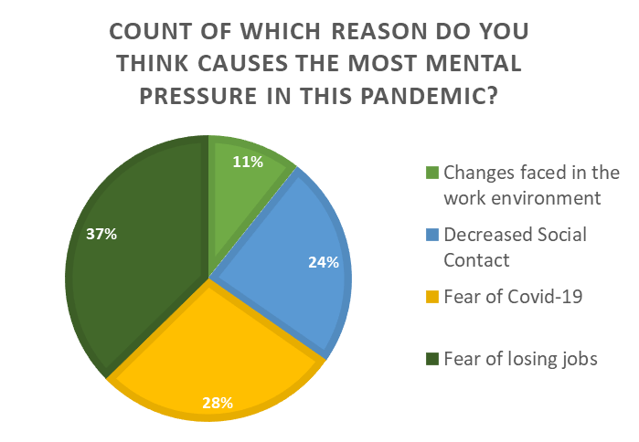
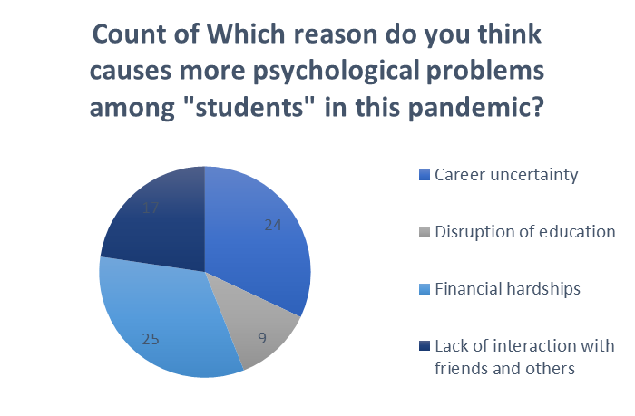
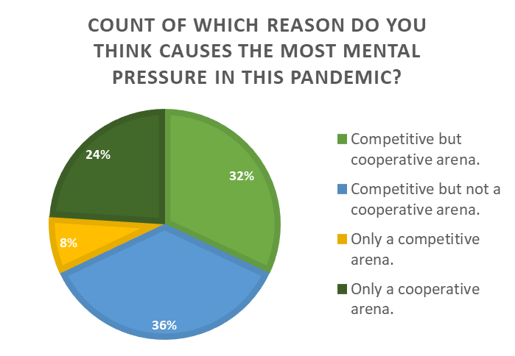
Jobs!, Financial hardship indicates economical problem. Increased competition indicates a rising alarm in suicides!

Slide 4
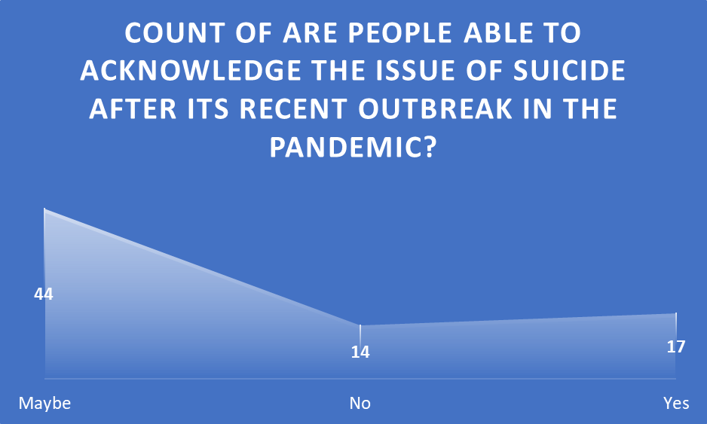
People are still skeptical about whether even the recent rise in suicides was able to address the much needed and sensitive issue of suicides.

Slide 5
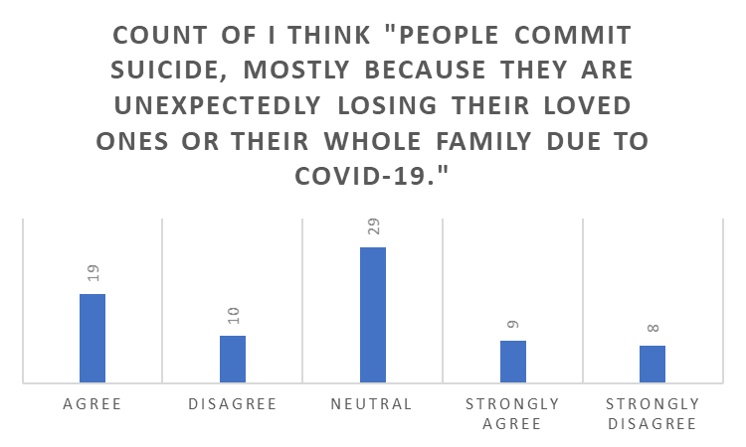
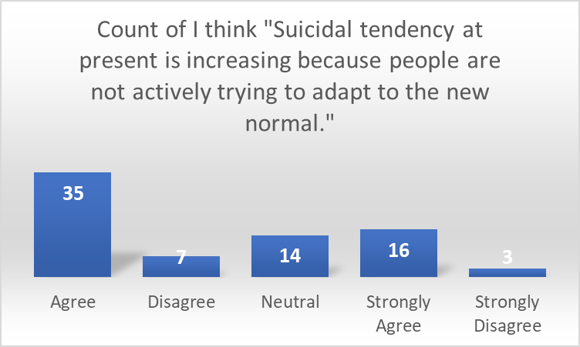
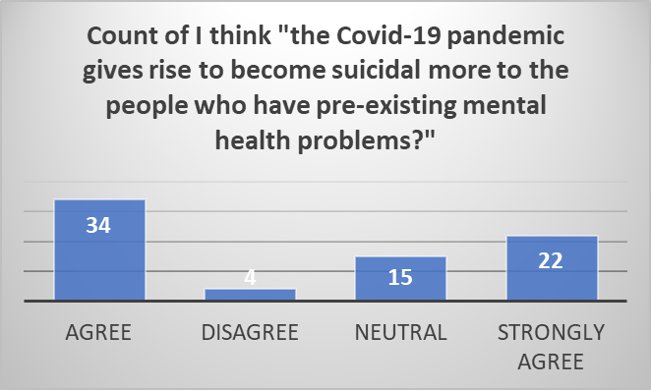
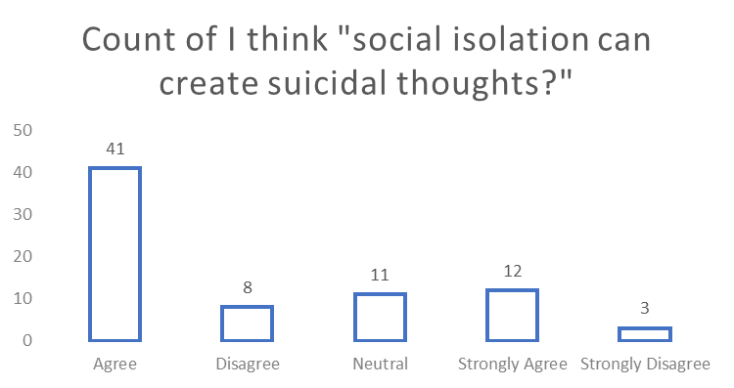
Losing people is not a reason, while social isolation is!

Slide 6
Which specific reason do you think impacts people to have increased mental pressure in the pandemic?
The uncertainty regarding future and the imminence of threat caused by corona. People are in an uncharacteristic zone of discomfort regarding as to future events as already many exams, projects have already been cancelled. And no one can guarantee one's life is safe from corona.
1. I think there are many reasons which impacts people to have increased mental pressure. Such as: * contamination fears * isolation distress *socio-economic concerns
Do you think economic disaster is one of the main reasons for increasing suicidal tendencies among the people during this pandemic? And Why do you think so?
I believe economic disasters plays an obvious role. Because if people find no secure livelihood or earning source, he can't provide himself or family. Even he Won't be able to support his family with medical costs. So a psychological impact of utmost inferiority develops due to this and may lead to suicidal attempts
The economic disaster has played a role in building mental pressure and suicidal tendencies among a lot of people. As many people tend to be very afraid of loosing their social status and also felt very uncertain about their future during the pandemic , it brought along suicidal tendencies in many.

Slide 7
What do you think about having an abusive family? Could it be the cause of someone's suicide?
Having an abusive family can be one of the main reasons of suicide especially during the pandemic as people had to spend alot more time at home. When families tend to break the confidence and create reasons to cause mental instability among individuals it can become a cause of suicide.
Of course. Having an abusive family hugely affects a child negatively. According to multiple research report, children who suffer physical and emotional abuse or neglect are at least two to three times more likely to attempt suicide in later life.
What is your take on social distancing? Are we missing the opportunity to share our stressors and therefore are being more burdened with it?
Social distancing is a necessary part of fighting this pandemic . A lot of people like to share their feelings and stress with their friends and peers which in terms helps them to deal with it. As social distancing is barrier to that activity it is causing us to be more burdened with the stress. Social distancing is also keeping us in isolation and giving us a lot of free time to unnecessarily overthink our problems further adding to the problem.
Social Distancing has put a limitation on our spontaneous human expressions. There is no alternative to live or face to face communication. So such desolation and over dependence on virtual world, makes our thoughts disorganized and increases the burden

Slide 8
Conclusion
People expressed on the favor, as they think job security, financial hardship and career uncertainty are the main reasons.
Participants also agree with our hypothesis as they think change in the new world, virtual connection is a problem.
Most people do not agree with our hypothesis as they are skeptical whether all of us are actually giving the issue a serious thought.

Slide 9
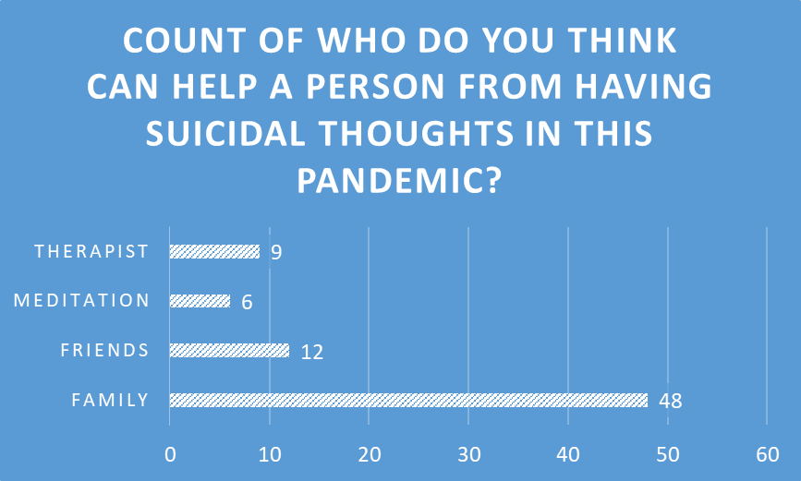
Recommendation
I think firstly , we should look into our family and create a great environment between our families as we have to spend almost all the time staying at home in this situation. We should be open with our parents and they also should be patient with our ways of thinking and increase communication. Families can be the key to avoiding the increase by just being there with the affected person and sometimes that is enough to take their mind out of such thoughts
mental support from friends and family and channelling the isolation into productive activities and most importantly keeping oneself entertained can be a way to avoid those thoughts
High time the parents and family member are taught about how to correctly behave with children, taken into sessions with psychiatrist, and pre-birth parents classes are made mandatory.

